Slide 1
Normative Ethics III: Virtue Ethics
Class 15
Philosophy 100
Introduction to Philosophy

Slide 2
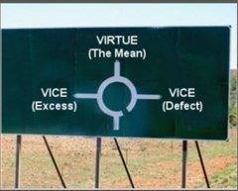
Virtue/Character-based Ethics
What does it mean to be a moral person? How does one become a moral person?

Slide 3
VE: An Overview
We have hitherto been discussing moral principles as a way to gauge what one ought to do.
This is a popular approach given the influence of Kantian and utilitarian ethics.
The ancients didn’t think about ethics as a set of principles from which to base the moral correctness of an action.
Ethics was about the qualities of what a person is and what it means to be a moral person.
In response to what ought I do, no rule or principle need be invoked; rather, a quality of character might be appealed to:
“Be brave”
“Be just”
“Be honest”
“Be lenient”
The question then changes to “What ought I be?”
What type of character should I have to be a moral agent?

Slide 4
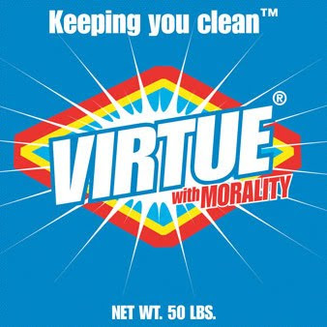
Virtue/Character-Based Ethics
An action is right if it is done for the right reasons, in the right way, by the right kind of person. In short, the right act is the virtuous one, and the virtuous act is the one done by a virtuous person.

Slide 5
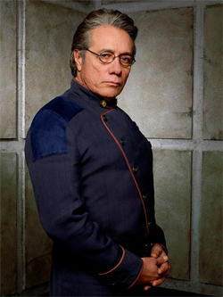
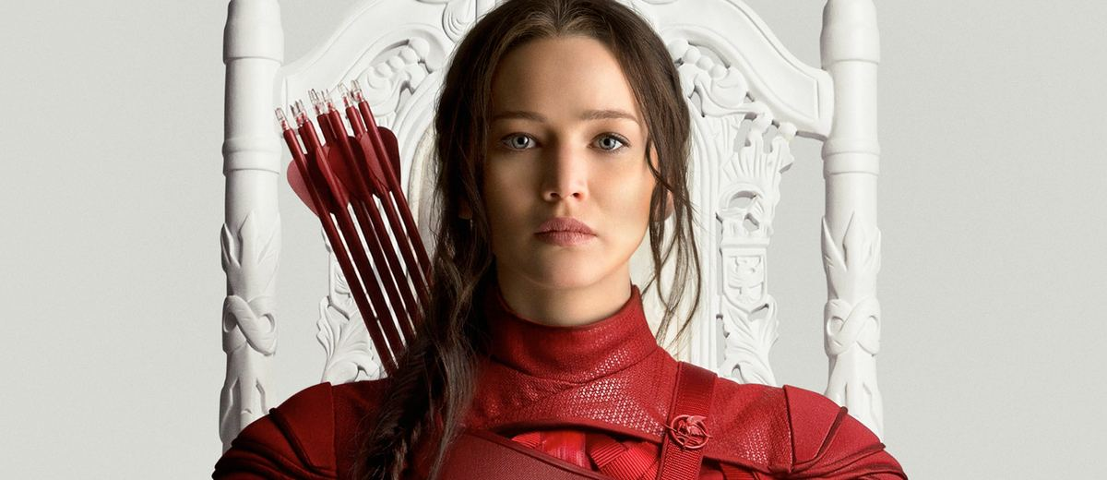
VE: Overview
One’s character is not merely a list of dispositions; it is an organic unity of something that is more than the sum of their parts. Be like so-and-so, who is an ideal character. Heroes and saints fit this bill—and those people did not give us principles to live by. They gave examples to be emulated.

Slide 6

What matters in moral decision making?

Slide 7
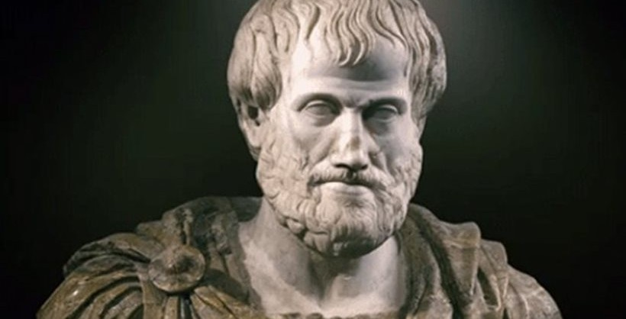
Aristotle (384BC – 322BC)
The GOAT
Referred to as “The Philosopher”
Studied pretty much everything:
Science
Logic
Ethics
Politics
Metaphysics
Epistemology
Wrote the book on virtue ethics: Nichomachean Ethics.

Slide 8
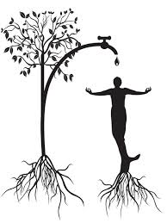
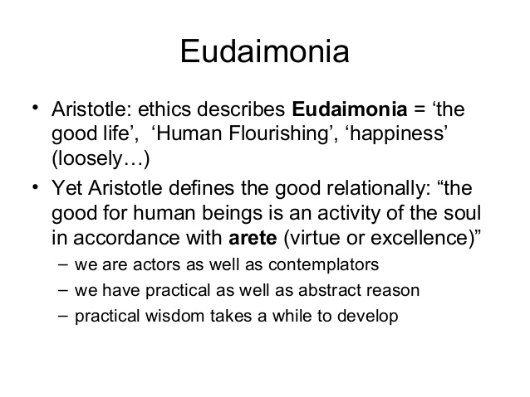
Main Features of Aristotle’s view
Eudaimonia: Happiness. This is the type of happiness that one can only achieve over the course of a lifetime and is contingent on being a virtuous.
We can think of this type of life as one that flourishes.
We do not simply live hand-to-mouth, but live with purpose and satisfaction

Slide 9
Levels of Virtue and Viciousness
Virtue
Vice
God-like virtue
can only be virtuous and has no conception of what it would be like otherwise.
The virtuous person
one who will act virtuously without desiring the vicious.
The non-vicious quasi virtuous person
acts virtuously, but desires to be vicious.
Monstrous viciousness
is always vicious with no conception of virtue.
The vicious person
acts viciously with no desire to be virtuous.
The non-virtuous quasi-vicious person
acts viciously, but desires to be virtuous.

Slide 10
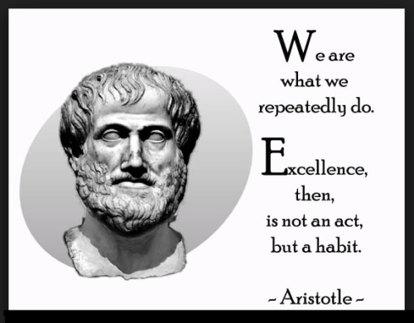
Virtue is not natural. It is a habit that we develop.
Virtues are developed through habitually acting virtuously and emulating those who are virtuous.
A good upbringing, moral education, sense of the political, and friendship all factor into this view.

Slide 11
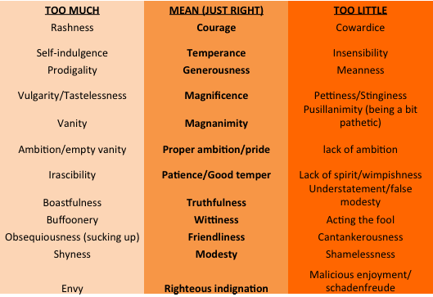
The Golden Mean
Vice Virtue Vice
The “Golden Mean”: Try to strike a balance between extremes when exercising one’s virtue in different situations.
Examples:
Courage is the appropriate response to a given situation. One is cowardly if one doesn’t go to battle at when one should; one is foolhardy if she goes running into battle full steam with no regard for safety then she is on the other end of the virtue spectrum.
Charity: Giving too much or nothing at all.
Justice: Mercy for horrible crimes and the death penalty for theft seem to be unjust.

Slide 12

Aristotle’s Ethics Summary
For Aristotle the right action is the action that is done for the right reasons, by the right types of person, at the right time in any given situation.
For example, sometimes Courage requires that we hold back, sometimes it requires that we charge. The virtuous person will now when wither will apply.
For those of us who are not god-like, we should be aware of our own inclinations and find the mean, which will result in being virtuous habitually, and then over the course of a lifetime reach eudaimonia, which is the goal or desired end for all. The good life.

Slide 13


